Slide 1

Connect Your Way: Custom Remote Transports with PowerShell
Justin Grote
Datacenter Solutions Architect, Microsoft MVP
Allied Digital Services LLC

Slide 2

Many thanks to our sponsors:

Slide 3

Thanks to Allied Digital Services LLC
Global leader with 35 years proven experience I Global Managed IT Services and Transformative Solutions I India’s Leading Master Systems Integrator
Why ADSL?
Core capabilities
Partner to 10 out of Fortune 100
Operating in 70 countries
Delivering complex sustainable projects
Digital Business Transformation DNA
Sound Financials
Consistent growth, QoQ, YoY
Cloud Transformation, DevOps and Engineering
Enterprise Infrastructure Management Services
Systems Integration – IoT, Smart Cities
CyberSecurity Services and Solutions
Service Management Platform, Automation, Mobility
Modern Workplace (End User) Services and Solutions
Differentiators
Awards & Accolades
Outcome based service model
Strategic 360 degree Industry partnerships
Wide spectrum of Technology Skills
Large contract capability, over USD 100M
Center of Excellence in Service Delivery
Systems Integration Capabilities
ISO 27001, ISO 20000, CMMI, SOC 2 Certified
Digital Transformation Platform PinkVerify Certified (ADiTaaS)
“CIO Choice” Award 2021 for managed IT servcies
“Best Under A Billion” Dollar Company by Forbes
“International Excellence Award” by Brands Impact
“Best Smart City Initiative Award” by World CSR
“Architecture Excellence Awards 2016” by ICMG
"Order of Merit - Innovative Smart Solution-Infrastructure“

Slide 4
Custom Transport Feature
Requires 7.3+ on the Client Side
Server can be whatever you want
Draft RFC: https://github.com/PowerShell/PowerShell-RFC/blob/master/Archive/Draft/RFC0063-Custom-Remote-Connections.md
Example Implementation: PaulHigin/NamedPipeConnection (github.com)

Slide 5

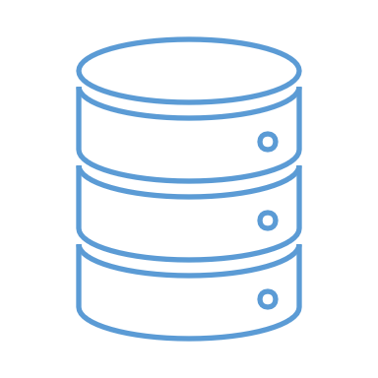


How Custom Transports Work
Get-ChildItem
<PSXML AAAABSREWERS… />
<PSXML XXXXAAF12FDKS… />
File1 File2 Directory2 Directory3 etc.
Client
Server
Transport

Slide 6
How Custom Transports Work
<PSXML XXXXAAF12FDKS… />
File1 File2 Directory2 Directory3 etc.
Client
Server
Get-ChildItem
<PSXML AAAABSREWERS… />
Transport

Slide 7
How Custom Transports Work
<PSXML XXXXAAF12FDKS… />
File1 File2 Directory2 Directory3 etc.
Client
Server
Get-ChildItem
<PSXML AAAABSREWERS… />

Slide 8
How Custom Transports Work
<PSXML XXXXAAF12FDKS… />
File1 File2 Directory2 Directory3 etc.
Client
Server
Get-ChildItem
<PSXML AAAABSREWERS… />

Slide 9

How Custom Transports Work
<PSXML XXXXAAF12FDKS… />
File1 File2 Directory2 Directory3 etc.
Client
Server
Get-ChildItem
<PSXML AAAABSREWERS… />
Transport Interface
{}
TextWriter WriteLine()
HandleDataReceived()
Transport

Slide 10
How Custom Transports Work
<PSXML XXXXAAF12FDKS… />
File1 File2 Directory2 Directory3 etc.
Client
Server
Get-ChildItem
Transport Interface
{}
<PSXML AAAABSREWERS… />
TextWriter WriteLine()
HandleDataReceived()
Transport

Slide 11
How Custom Transports Work
<PSXML XXXXAAF12FDKS… />
File1 File2 Directory2 Directory3 etc.
Client
Server
Get-ChildItem
Transport Interface
{}
<PSXML AAAABSREWERS… />
TextWriter WriteLine()
HandleDataReceived()
Transport

Slide 12
How Custom Transports Work
<PSXML XXXXAAF12FDKS… />
File1 File2 Directory2 Directory3 etc.
Client
Server
Get-ChildItem
Transport Interface
{}
<PSXML AAAABSREWERS… />
TextWriter WriteLine()
HandleDataReceived()
Transport

Slide 13
How Custom Transports Work
<PSXML XXXXAAF12FDKS… />
File1 File2 Directory2 Directory3 etc.
Client
Server
Get-ChildItem
Transport Interface
{}
TextWriter WriteLine()
HandleDataReceived()
<PSXML AAAABSREWERS… />
Transport

Slide 14
How Custom Transports Work
<PSXML XXXXAAF12FDKS… />
File1 File2 Directory2 Directory3 etc.
Client
Server
Get-ChildItem
Transport Interface
{}
TextWriter WriteLine()
HandleDataReceived()
<PSXML AAAABSREWERS… />
Transport

Slide 15
How Custom Transports Work
<PSXML XXXXAAF12FDKS… />
File1 File2 Directory2 Directory3 etc.
Client
Server
Get-ChildItem
<PSXML AAAABSREWERS… />
Transport Interface
{}
Transport
TextWriter WriteLine()
HandleDataReceived()

Slide 16
How Custom Transports Work
<PSXML XXXXAAF12FDKS… />
<PSXML AAAABSREWERS… />
File1 File2 Directory2 Directory3 etc.
Client
Server
Get-ChildItem
Transport Interface
{}
Transport
TextWriter WriteLine()
HandleDataReceived()

Slide 17
How Custom Transports Work
File1 File2 Directory2 Directory3 etc.
Client
Server
Get-ChildItem
Transport Interface
{}
TextWriter WriteLine()
HandleDataReceived()
Transport

Slide 18
How Custom Transports Work
Client
Server
Get-ChildItem
<PSXML XXXXAAF12FDKS… />
Transport Interface
{}
TextWriter WriteLine()
HandleDataReceived()
Transport

Slide 19
How Custom Transports Work
Client
Server
Get-ChildItem
Transport Interface
{}
<PSXML XXXXAAF12FDKS… />
TextWriter WriteLine()
HandleDataReceived()
Transport

Slide 20
How Custom Transports Work
Client
Server
Get-ChildItem
Transport Interface
{}
TextWriter WriteLine()
HandleDataReceived()
<PSXML XXXXAAF12FDKS… />
Transport

Slide 21
How Custom Transports Work
Client
Server
Get-ChildItem
Transport Interface
{}
<PSXML XXXXAAF12FDKS… />
TextWriter WriteLine()
HandleDataReceived()
Transport

Slide 22
How Custom Transports Work
Client
Server
Get-ChildItem
File1 File2 Directory2 Directory3 etc.
Transport Interface
{}
TextWriter WriteLine()
HandleDataReceived()
Transport

Slide 23
How Custom Transports Work
Client
File1 File2 Directory2 Directory3 etc.
Server
Get-ChildItem
Transport Interface
{}
TextWriter WriteLine()
HandleDataReceived()
Transport

Slide 24
Custom Transport Components
Connection Info
Implements RunspaceConnectionInfo
Client Session Transport Manager
Implements BaseClientSessionTransportManager
Cmdlets
Technically optional but usually implemented
Friendly UX to prepare the connection info and creating the Runspace
Should hold any config or state info about the specific connection… but optional
Gets created by the Connection Info and generally pretty tightly coupled
Has hooks to open/close/send/receive
Called by RunspaceFactory to create the transport manager
Can have many-to-one relationship of Connection Infos to Transport Manager (this is hard though)

Slide 25
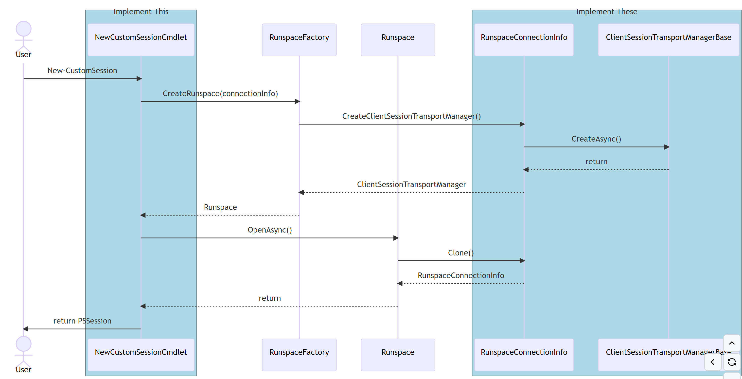
Custom Transport New Connection

Slide 26
PoshAnywhere
https://github.com/justingrote/poshanywhere
Uses Websockets as the transport mechanism
Server written entirely in PowerShell, 5.1+ supported, no dependencies
Adds Cloudflare Quick Tunnels for easy rendezvous
Works with all firewalls that allow outbound HTTPS to CloudFlare

Slide 27
Demo Time!
We love Demos!

Slide 28
Q&A

